Slide 1
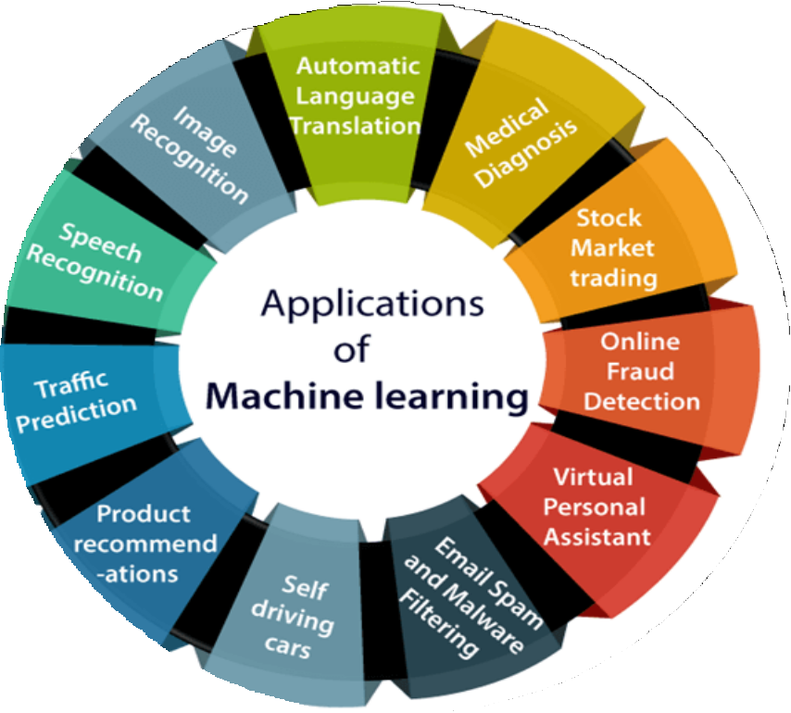


Slide 2
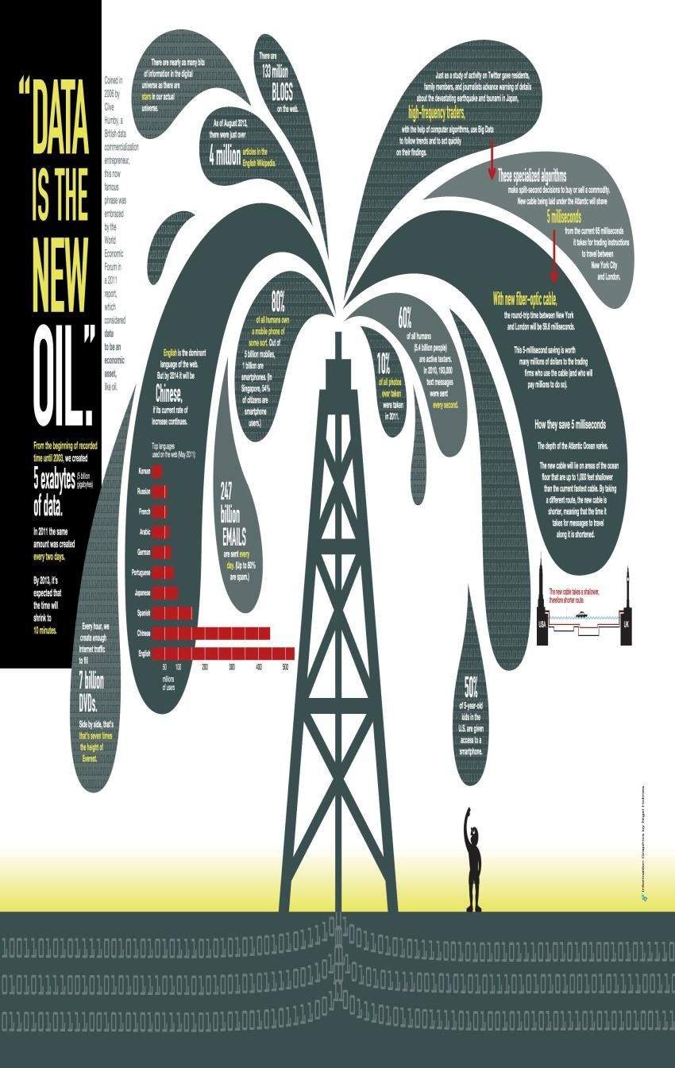
Why Machine Learning hype?
Data is the new Oil!!!
Enough Data but Scarce Knowledge
1 trillion web pages – Web mining
One hour of video is uploaded to YouTube
every second amounting to 10 years of content every day
1M transactions per hour in Walmart
Science – Bioinformatics, Astrophysics... Genomes 1000s of people, each of which has a length of 3.8 × 109 base pairs sequenced by various labs;

Slide 3
Why Machine Learning is inevitable ?
Intellectually rich due to Mathematics and Algorithms
Human design has limitations
NLP, Computation, handwriting recognition
Dynamic Environment
Autonomous helicopter, self driving car
New knowledge evolved and redesign is difficult
Self customizing programs
Amazon product recommender system.
DATA DOES THE TRICK !!!

Slide 4
Machine Learning Applications
Applications Stakeholders
Doctors
Netflix, Amazon
Social media like Facebook
Web service providers
Google assistant, Amazon Alexa
Tesla
Financiers
Disease Diagnostics
Recommendation
Image Tagging
Advertising
Speech Processing
Self-driving car
Share Trading

Slide 5
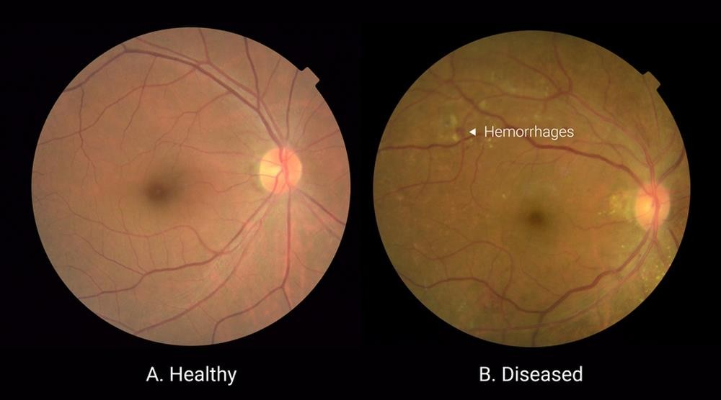
Disease Diagnostics (Computer Vision)
Diagnose Diabetic Retinopathy
Source : https://blog.google/technology/ai/detecting-diabetic-eye-disease-machine-learning/

Slide 6
T, E, P for Diabetic Retinopathy
Task : Specific work
Diagnose if the patient has Diabetic Retinopathy or not (Classification)
Experience : Data available
Eye images of various DR/non-DR patients
Performance : Accurately perform work Correctly diagnosed DR patients

Slide 7
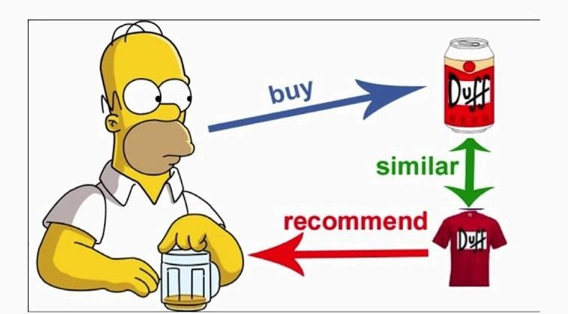
Recommendation Systems

Slide 8


Share Trading

Slide 9
T, E, P for Share Trading
Task : Specific work
What will be the share price of HDFC after a week (Regression)
Experience : Data available
For each date, the opening price, closing, high, low buying etc. since 5 years
Performance : Accurately perform work
How closer was the predicted price to the actual price.

Slide 10
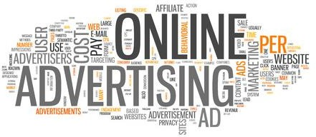

Slide 11
References
https://towardsdatascience.com/build-your-own-recommender-system-within-5-
minutes-30dd40388fbf
https://blog.google/technology/ai/detecting-diabetic-eye-disease-machine- learning/
https://in.pinterest.com/pin/345369865144445661/
https://www.livemint.com/money/personal-finance/paytm-to-start-share- trading-services-soon-11578294511902.html
https://www.adspeed.com/Blog/Five-most-common-online-advertising-mistakes- 1692.html
https://www.javatpoint.com/applications-of-machine-learning

Slide 12
